Slide 1
NED University | Dept. of Computational Finance
Forecasting Pakistan
Pension System Using
Machine Learning
Group Members:
FAISAL (CF-22035)
M.HARIS (CF-22072)
LAIQA (CF-22041)
DANIYAL GUL (CF-22036)
Supervisor: Dr. Ubaida Fatima | Batch 2022 | © NED University 2026

Slide 2
AGENDA
01
06
Introduction & Background
EDA & Key Trends
02
07
Problem Statement & Objectives
Results by Company
Presentation
Outline
03
08
Literature Review
Cross-Company Comparison
04
09
Dataset & Methodology
Forecasts 2025–2026
05
10
ML Models Applied
Conclusions & Recommendations

Slide 3
Introduction & Background
1
Introduction
Background
Pakistan operates a Pay-As-You-Go (PAYG) pension system
Sensitive to demographics (aging) and economy (inflation, salary growth)
Pension spending growing faster than revenue sustainability concerns
Current forecasting uses periodic actuarial valuations with fixed assumptions
Pakistan's pension system faces rising fiscal pressure from aging population and growing liabilities
Accurate forecasting is critical for budgeting and policy reform
Traditional methods rely on fixed, linear assumptions
ML offers adaptive, data-driven forecasting
PAYG Model
73%
2050

Slide 4
2
Problem Statement
PAYG model heavily strains national budget
Favours public sector, neglects informal/private workers
Rising life expectancy increases dependency ratio
No ML-based forecasting for Pakistan's corporate pension context
Absence of company-specific IAS 19 forecasting tools

Slide 5
3
Objectives
Study Objectives
Collect 10yr IAS 19 data (2015–2024) from 8 PSX firms
Implement 5 ML models: LR, RF, ARIMA, XGBoost, CatBoost
Evaluate using MSE, RMSE, MAE, R² per company
Identify best-performing model for each company
Provide company-specific policy recommendations

Slide 6
4
Literature Review — Key Studies
2010–2019
Ahmed (2010), Arif & Ahmed (2012), Wahab et al. (2017), Salazar & Boado-Peñas (2019)
Pakistan PAYG unsustainable; dependency ratio rising 12.6%→21.7% by 2050; LR outperformed NNs for retirement prediction.
2019–2021
Aguirre et al. (2019), Wu (2019), Wang & Huang (2021)
Boosted Decision Tree R²=99.997% on Peru AFP data; Logistic models achievable for linear pension trajectories.
2022–2025
Ahmad (2024), Hayman (2024), Chek et al. (2025), Dewah et al. (2025)
XGBoost & RF dominate; ANNs achieve MAPE=3.2% (Malaysia SOCSO); XGBoost 98.2% accuracy (Zimbabwe). Success concentrated in mature systems.

Slide 7
5
Literature Review — Key Studies
2022–2025
Ahmad (2024), Hayman (2024), Chek et al. (2025), Dewah et al. (2025)
XGBoost & RF dominate; ANNs achieve MAPE=3.2% (Malaysia SOCSO); XGBoost 98.2% accuracy (Zimbabwe). Success concentrated in mature systems.
Veludandi (2026) XGBoost dominated retirement risk prediction (93.33% accuracy; ROC-AUC=0.982, USA). Home-Secured Debt identified as the strongest predictor, highlighting ML effectiveness in complex financial systems.
2026

Slide 8
6
Research Gap
Limited use of ML in Pakistani pension research.
No comparison of ARIMA, RF, XGBoost, and CatBoost.
Lack of PSX company-level pension forecasting.
No integrated pension forecasting framework.
Absence of decision-support tools for pension management.
2026

Slide 9
7
Dataset 8 PSX-Listed Companies
HBL
OGDCL
PPL
SECP
Habib Bank Limited
Oil & Gas Dev. Co.
Pakistan Petroleum
Securities & Exchange
Comm. of Pakistan
Banking
Energy
Energy
Regulator
NBP
SSGC
PIA
PAKOXY
National Bank of Pak.
Sui Southern Gas Co.
Pakistan Int'l Airlines
Pakistan Oxygen Ltd.
Banking
Utility
Aviation
Industrial
Data Source: IAS 19 Notes from Annual Audited Financial Statements (2015–2024) | 10 years × 8 companies = 80 observations | 9 Features

Slide 10
8
Methodology & Dataset Variables
IAS 19 Features Used
Preprocessing Steps
Opening Obligation
Start-of-year defined benefit obligation
1
Missing Values
Current Service Cost
Benefits earned in current period
Forward-fill imputation
2
Standardization
Interest Cost
Interest on the DBO
All values → PKR thousands
Actuarial Gain/Loss
Assumption change impact (volatile)
3
Outlier Detection
IQR method applied
Benefits Paid
Pensions paid to retirees
4
Feature Engineering
Discount Rate (%)
Drives present-value discounting
YoY growth rates derived
Exp. Salary Increase
Future salary growth assumption
5
Train/Test Split
Company-wise structured splits
Exp. Pension Increase
Future pension growth assumption
Export
6
→ Closing Obligation
TARGET VARIABLE (IAS 19 year-end DBO)
Clean CSVs for Python modelling

Slide 11
9
Five ML Models Applied
LR
RF
AR
CB
XG
Linear
Regression
Random
Forest
ARIMA
CatBoost
XGBoost
Statistical Baseline
Ensemble: Bagging
Time-Series
Gradient Boosting
Gradient Boosting
OLS minimizes squared residuals; captures linear pension trends.
B bootstrap trees, random feature selection; robust to outliers.
p-d-q model; uses AIC/BIC for order selection; univariate.
Ordered boosting + symmetric trees; handles complex interactions.
Regularized objective + 2nd-order Taylor expansion; state-of-art.
Evaluation Metrics: MSE • RMSE • MAE • R² (applied company-wise)

Slide 12
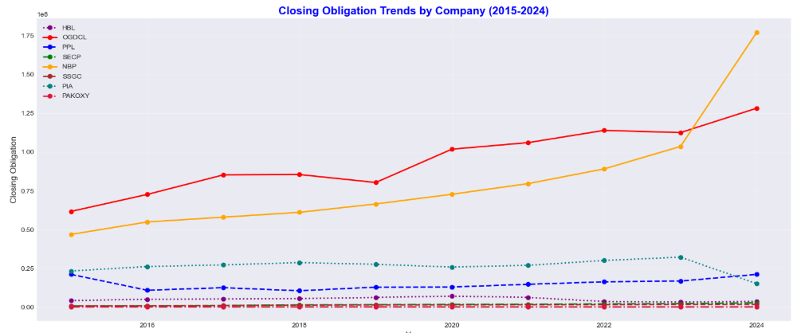
10

Slide 13
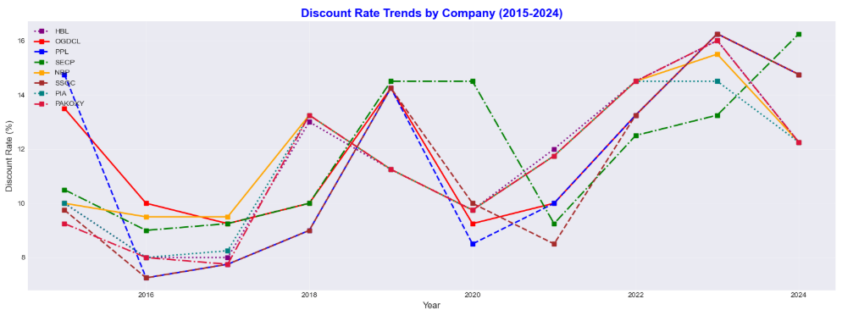
11

Slide 14
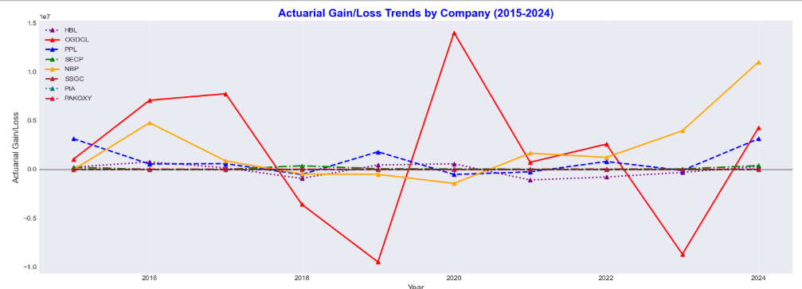
12

Slide 15
HBL — Model Performance
13
R² by Model
Model | MSE | RMSE | MAE | R²
Linear Reg. | 0.295 | 0.543 | 0.468 | -0.181
Random Forest | 0.179 | 0.423 | 0.395 | 0.283
ARIMA | 2.002 | 1.415 | 1.174 | -7.006
XGBoost | 0.035 | 0.186 | 0.145 | 0.862
CatBoost | 0.09 | 0.3 | 0.247 | 0.639
✔ High Accuracy: R²=0.86, lowest RMSE=0.186
✖ Low Accuracy: R²=-7.01, highest error
Machine Learning Model Evaluation | Stock Price Prediction

Slide 16
OGDCL — Model Performance
14
R² by Model
Model | MSE | RMSE | MAE | R²
Linear Regression | 0.010343 | 0.101701 | 0.082238 | 0.958627
Random Forest | 0.018794 | 0.137093 | 0.132438 | 0.924822
ARIMA | 0.41848 | 0.6469 | 0.63292 | -0.67392
XGBoost | 0.048206 | 0.219558 | 0.156848 | 0.807178
CatBoost | 0.051937 | 0.227898 | 0.176687 | 0.792251
✔ High Accuracy: R²=0.96, lowest RMSE=0.102
✖ Low Accuracy: R²=-0.67, highest error
Machine Learning Model Evaluation | Stock Price Prediction

Slide 17
PPL — Model Performance
15
R² by Model
Model | MSE | RMSE | MAE | R²
Linear Regression | 0.142618 | 0.377648 | 0.289857 | 0.429527
Random Forest | 0.113118 | 0.33633 | 0.336297 | 0.547529
ARIMA | 0.72476 | 0.851328 | 0.770857 | -1.89904
XGBoost | 0.040065 | 0.200163 | 0.143466 | 0.839739
CatBoost | 0.247912 | 0.497907 | 0.478968 | 0.008353
✔ High Accuracy: R²=0.84, lowest RMSE=0.200
✖ Low Accuracy: R²=-1.90, highest error
Machine Learning Model Evaluation | Stock Price Prediction

Slide 18
SECP — Model Performance
16
R² by Model
Model | MSE | RMSE | MAE | R²
Linear Regression | 0.00438 | 0.066181 | 0.048484 | 0.98248
Random Forest | 0.011409 | 0.106813 | 0.079136 | 0.954364
ARIMA | 0.254782 | 0.50476 | 0.39902 | -0.019129
XGBoost | 0.003574 | 0.059787 | 0.057455 | 0.985702
CatBoost | 0.016989 | 0.130343 | 0.11422 | 0.932043
✔ High Accuracy: R²=0.99, lowest RMSE=0.060
✖ Low Accuracy: R²=-0.02, highest error
Machine Learning Model Evaluation | Stock Price Prediction

Slide 19
NBP — Model Performance
17
R² by Model
Model | MSE | RMSE | MAE | R²
Linear Regression | 0.018027 | 0.134266 | 0.133422 | 0.927891
Random Forest | 0.017322 | 0.131612 | 0.131077 | 0.930713
ARIMA | 0.415013 | 0.644215 | 0.509227 | -0.660051
XGBoost | 0.019024 | 0.137929 | 0.09896 | 0.923902
CatBoost | 0.007634 | 0.087371 | 0.086337 | 0.969465
✔ High Accuracy: R²=0.97, lowest RMSE=0.087
✖ Low Accuracy: R²=-0.66, highest error
Machine Learning Model Evaluation | Stock Price Prediction

Slide 20
SSGC — Model Performance
18
R² by Model
Model | MSE | RMSE | MAE | R²
Linear Regression | 1.091694 | 1.044842 | 0.799503 | -3.366775
Random Forest | 0.02915 | 0.170735 | 0.138178 | 0.883399
ARIMA | 46.212465 | 6.797975 | 6.719242 | 0.07
XGBoost | 0.026555 | 0.162957 | 0.16096 | 0.89378
CatBoost | 0.028063 | 0.16752 | 0.166484 | 0.887749
✔ High Accuracy: R²=0.89, lowest RMSE=0.163
✖ Low Accuracy: R²=-3.37, highest error
Machine Learning Model Evaluation | Stock Price Prediction

Slide 21
19
PIA — Model Performance
R² by Model
Model | MSE | RMSE | MAE | R²
Linear Regression | 0.559189 | 0.747789 | 0.54466 | -1.236755
Random Forest | 0.521584 | 0.722208 | 0.626114 | -1.086335
ARIMA | 0.526414 | 0.725544 | 0.560969 | -1.105654
XGBoost | 0.564405 | 0.751269 | 0.687069 | -1.257618
CatBoost | 0.249566 | 0.499566 | 0.457202 | 0.001736
✔ High Accuracy: R²=0.002 lowest RMSE=0.500
✖ Low Accuracy: R²=-1.26, highest error
Machine Learning Model Evaluation | Stock Price Prediction

Slide 22
PAKOXY — Model Performance
20
R² by Model
Model | MSE | RMSE | MAE | R²
Linear Regression | 0.124679 | 0.353099 | 0.333595 | 0.501285
Random Forest | 0.212458 | 0.460932 | 0.394637 | 0.150166
ARIMA | 0.552934 | 0.743596 | 0.651198 | -1.211737
XGBoost | 0.08575 | 0.292831 | 0.269191 | 0.657
CatBoost | 0.177187 | 0.420935 | 0.322901 | 0.291254
✔ High Accuracy: R²=0.66, lowest RMSE=0.293
✖ Low Accuracy: R²=-1.21, highest error
Machine Learning Model Evaluation | Stock Price Prediction

Slide 23
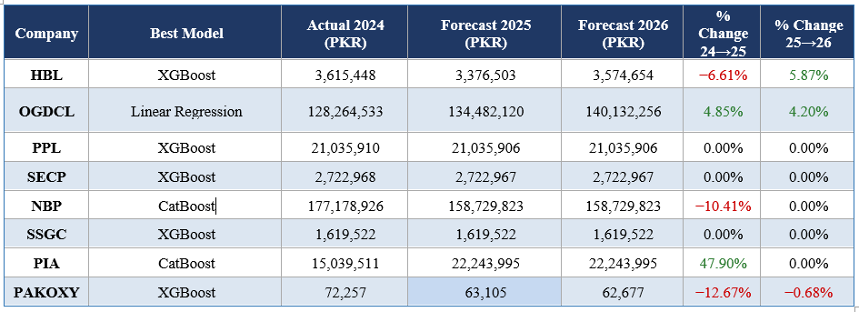
21
Closing Obligation Forecasts — 2025 & 2026

Slide 24
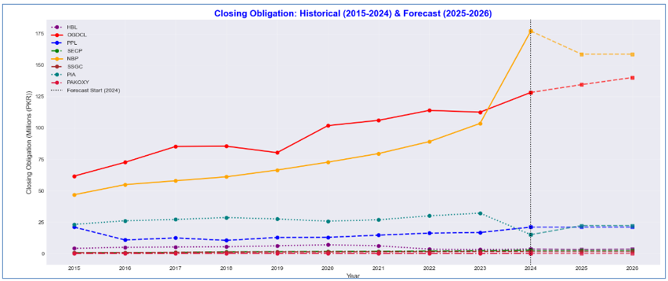
22
Closing Obligation Forecasts — 2025 & 2026

Slide 25
23
Why XGBoost Dominates — Technical Insights
1
2
Regularized Objective
Non-linear Capture
Combines training loss + complexity penalty (γT + λΣwj²). Controls overfitting on small 10-point datasets better than vanilla gradient boosting.
2nd-order Taylor expansion for precise gradient updates. Captures actuarial gain/loss volatility and interest rate non-linearities that ARIMA misses.
3
4
Feature Importance
Small-Data Robustness
HBL: Salary Increase 53.5% dominant. SSGC: Benefits Paid 55.8%. Company-specific insights guide actuarial sensitivity analysis.
Level-wise tree growth with depth-first pruning balances expressiveness vs. generalisation — critical given only 10 annual observations per company.
Exception: OGDCL — Linear Regression wins (Occam's Razor: when data is linear, simpler models generalize better on small N)

Slide 26
24
Company-Specific Policy Recommendations
HBL
OGDCL
XGBoost annual update. 15–20% reserve buffer. Independent actuary validation. Salary escalation sensitivity ±1–2%.
Deploy XGBoost as parallel scenario model alongside LR. Proactive IAS 19 governance. Long-term workforce transition plan.
NBP
SECP
CatBoost as primary model. Discontinue ARIMA entirely. Automated actuarial data pipeline for annual retraining.
Embed 3–5yr rolling forecast in budgeting cycle. Issue ML-based IAS 19 best practice guidelines for PSX-listed firms.
SSGC
PIA
XGBoost mandatory. Ensemble consensus (XGBoost+RF+CatBoost) for scenario banding. Investigate step-change root causes.
Do NOT use ML. Commission full IAS 19 actuarial review. Scenario-based stress testing (base/optimistic/adverse). Revisit ML after 5yr stable data.
PPL & PAKOXY: Annual XGBoost model review cycles with expanding datasets for improved precision over time

Slide 27
25
Limitations
Small sample: only 10 annual obs. per company limits ML statistical power
PIA & SSGC data quality issues constrain generalisation
No macroeconomic variables: KIBOR, CPI, sector wage indices excluded
No formal hyperparameter optimization (grid search/Bayesian tuning)
IAS 19 assumption changes not modelled prospectively

Slide 28
26
Future Research Directions
Future Research Directions
Expand to all PSX-listed companies with IAS 19 disclosures
Integrate KIBOR, CPI, sector wage growth as ML features
Explore LSTM & Temporal CNN when longer time series available
Develop 3-scenario stress tests: optimistic / base / adverse
South Asian benchmarking: India, Bangladesh, Sri Lanka

Slide 29
27
Conclusions
XGBoost best for 5/8 companies
CatBoost optimal for NBP (R²=0.970)
Linear Reg. wins for linear OGDCL (R²=0.959)
ARIMA fails universally ,unsuitable for multi-driver pension data
PIA: ML inapplicable under structural financial distress
Pakistan's pension liabilities rising ML is a strategic necessity

Slide 30
REFERENCES
[1] Mahmood, N. (2008). Pension and Social Security Schemes in Pakistan: Some Policy Options. Pakistan Institute of Development Economics (PIDE).
[2] Wahab, M., Mufti, O., & Khan, M. A. (2017). The Effects of Population Ageing on the Public Pension System in Pakistan. Abasyn Journal of Social Sciences.
[3] Ahmad, R. (2024). Cloud-enabled machine learning framework for real-time pension fund risk prediction using gradient boosting and deep neural networks. Journal of Financial Risk Management, 13(4), 215–234.
[4] Hayman, J. (2024). Artificial intelligence in global pension management: A survey of deployment across pension assets. Journal of Pension Economics & Finance, 23(3), 312–334.
[5] Chek, M. L., Ismail, N., et al. (2025). Forecasting pension claim frequencies using ARIMA, decision trees, and artificial neural networks: Evidence from Malaysia's SOCSO.
[6] Dewah, P., Chaputsira, G., & Muzava, M. (2025). Predicting retirement motives using machine learning: Evidence from Zimbabwe.
[7] Veludandi, S. (2026). Targeted retirement and investment plans for under-saved families: A machine learning approach using Survey of Consumer Finance data. Preprints.

Slide 31
THANK YOU
FEEL FREE TO ASK
QUESTION

